Slide 1

LIBRARY MANAGEMENT SYSTEM
PRESENTED BY :-
ADARSH KUMAR
C-13
40796402718

Slide 2



INTRODUCTION
Python for Everybody Specialization
This Specialization introduces to fundamental programming concepts including data structures, networked application program interfaces, and databases, using the Python programming language. We Learn to Program and Analyze Data with Python and develop programs to gather, clean, analyze, and visualize data.

Slide 3
COURSE | SKILLS LEARNT
Programming for Everybody | BASIC PROGRAMMING PYTHON PROGRAMMING PYTHON SYNTAX AND SEMANTICS
Python Data Structures | LIST TUPLES DICTIONARIES
Using Python to Access Web Data | XML JSON WEB SCRAPING
Using Databases with Python | SQL SQLITE3 DATABASE (DBMS)

Slide 4
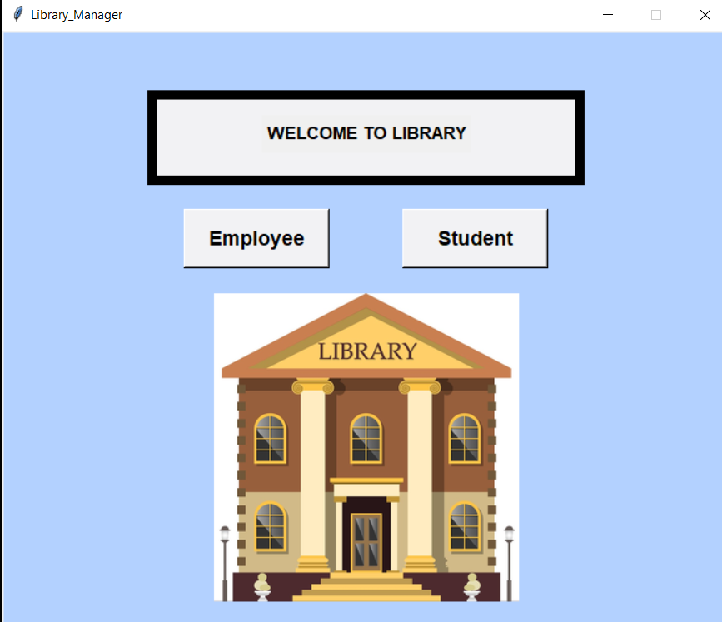
PROJECT
TOOLS & TECHNOLOGIES
BACK – END : MYSQL
LANGUAGE : PYTHON
FRONT – END : TKINTER
EDITOR : ATOM TEXT EDITOR
DASHBOARD
EMPLOYEE
STUDENT
HOME PAGE

Slide 5
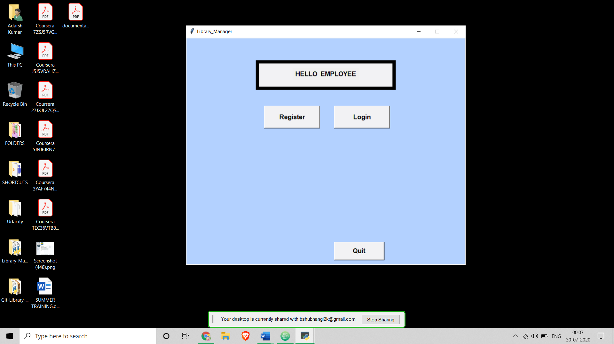
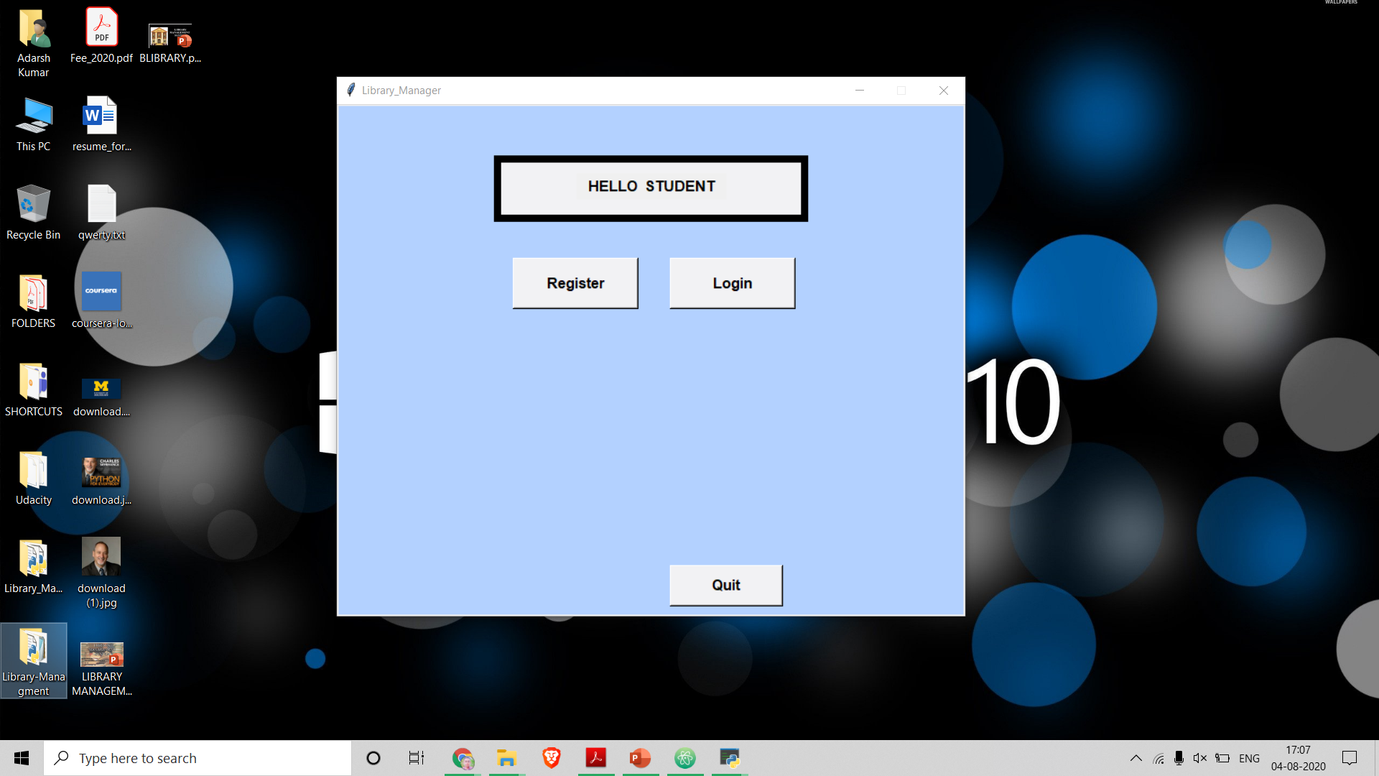
SIGN UP MENU
EMPLOYEE
STUDENT

Slide 6
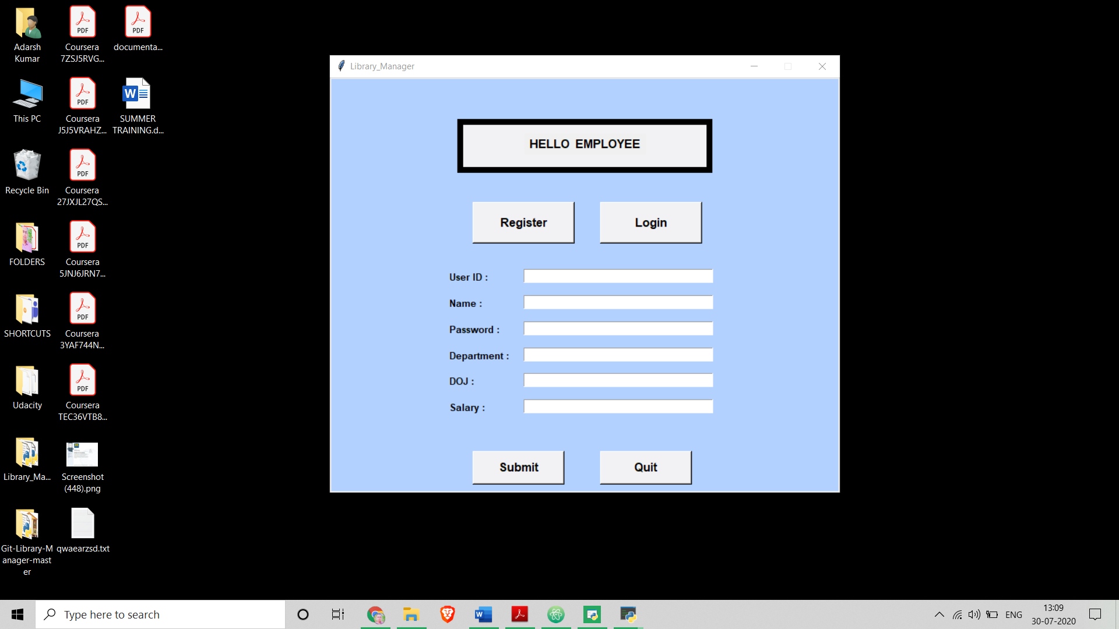
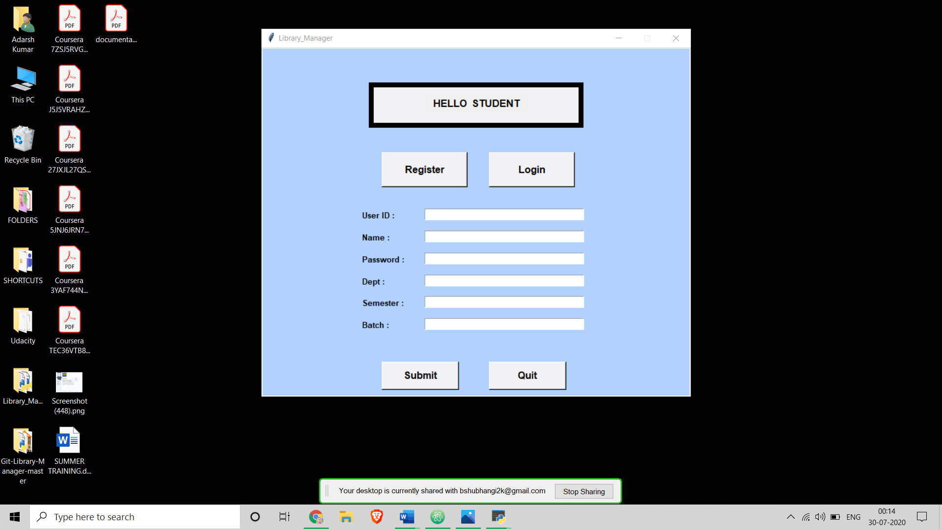
REGISTRATION
EMPLOYEE
STUDENT

Slide 7
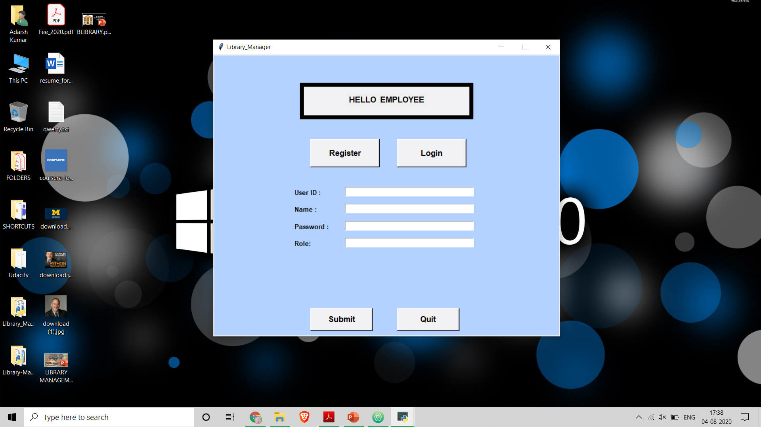
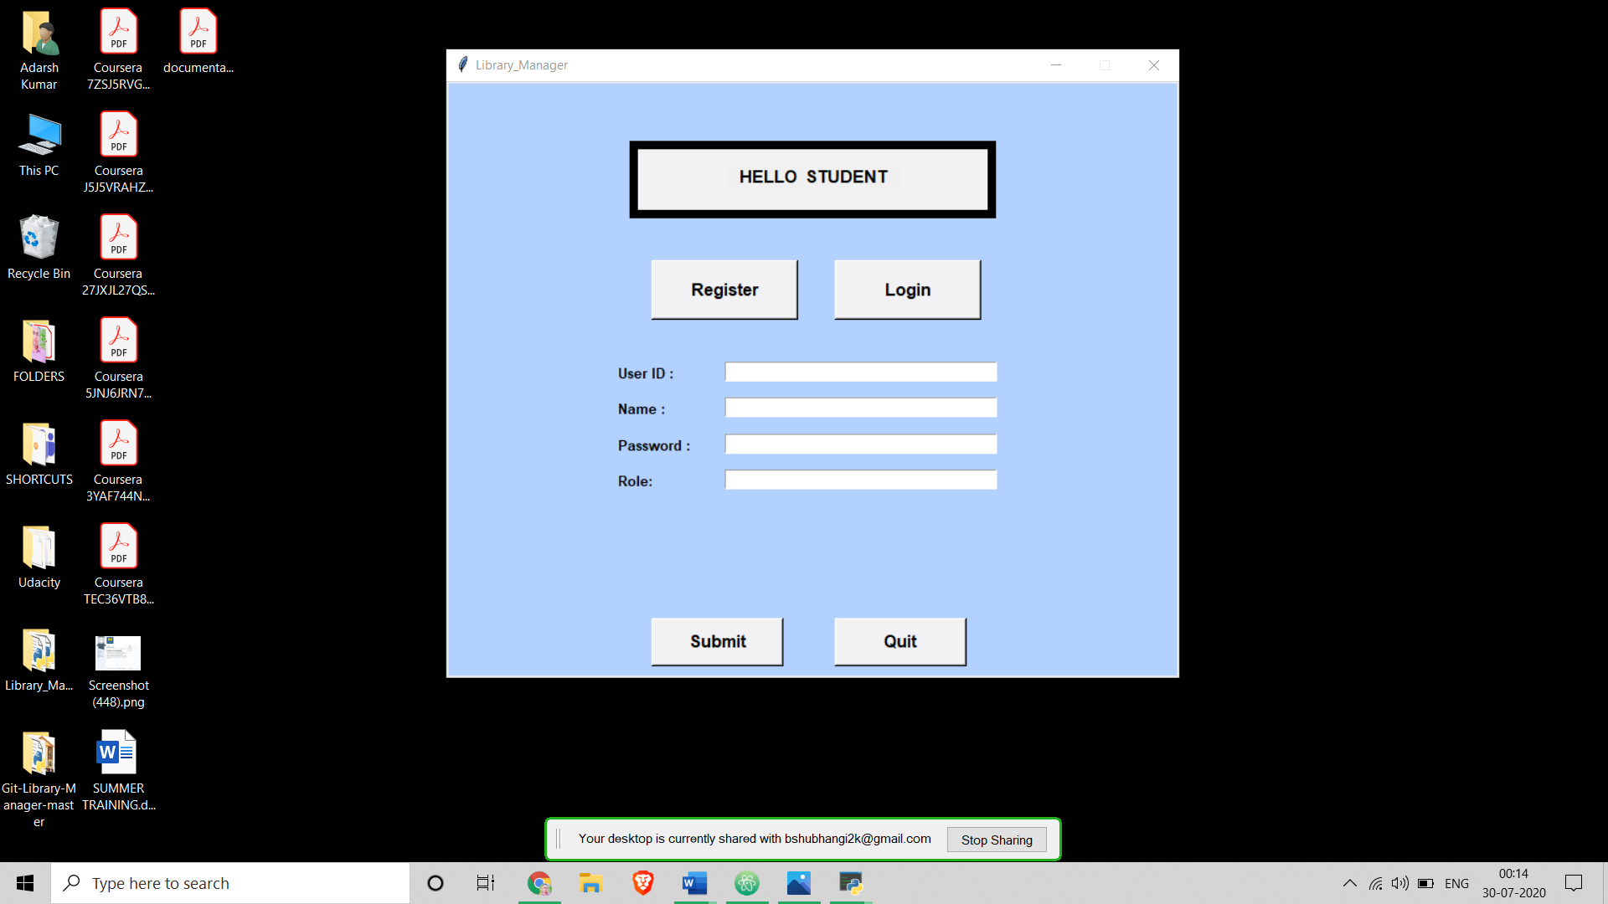
LOG IN
EMPLOYEE
STUDENT

Slide 8
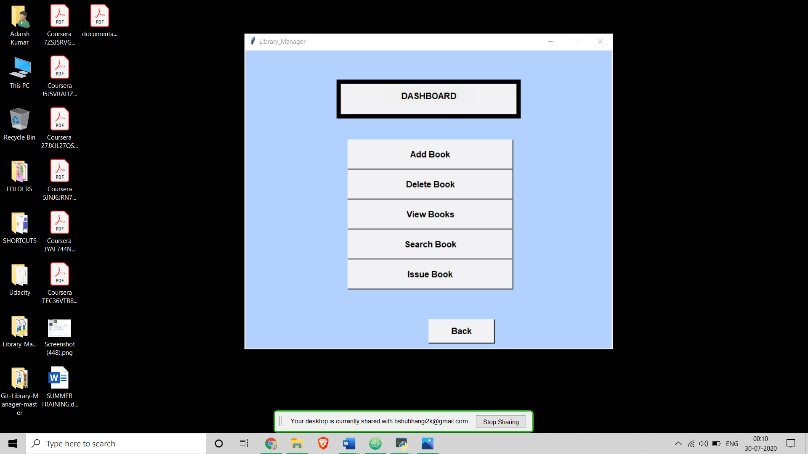
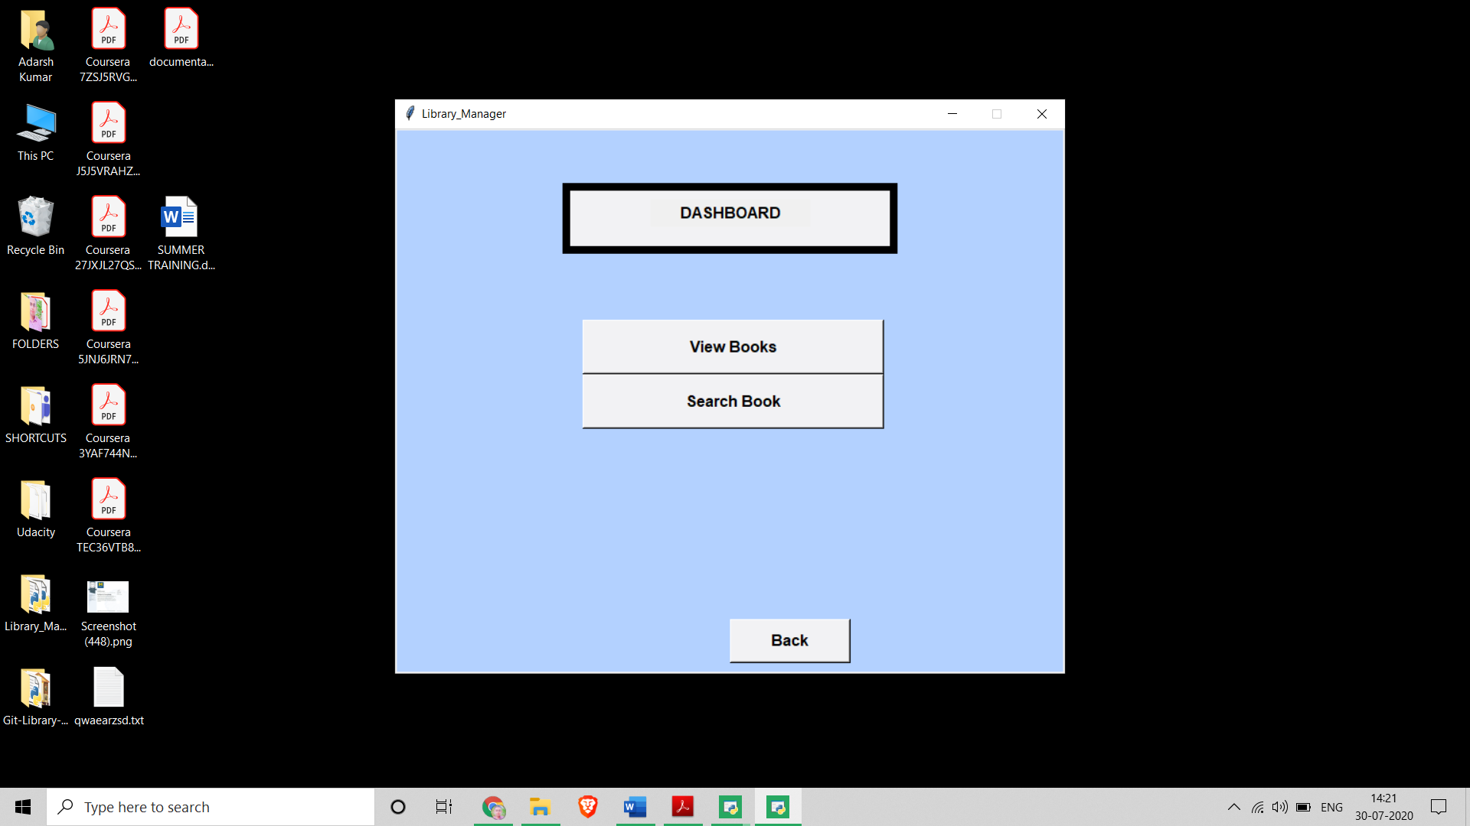
USER DASHBOARD
EMPLOYEE
STUDENT

Slide 9
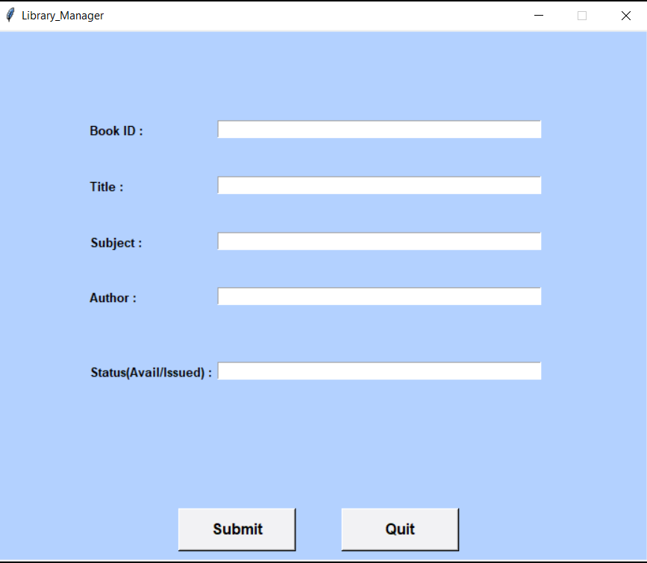
ADD BOOK

Slide 10
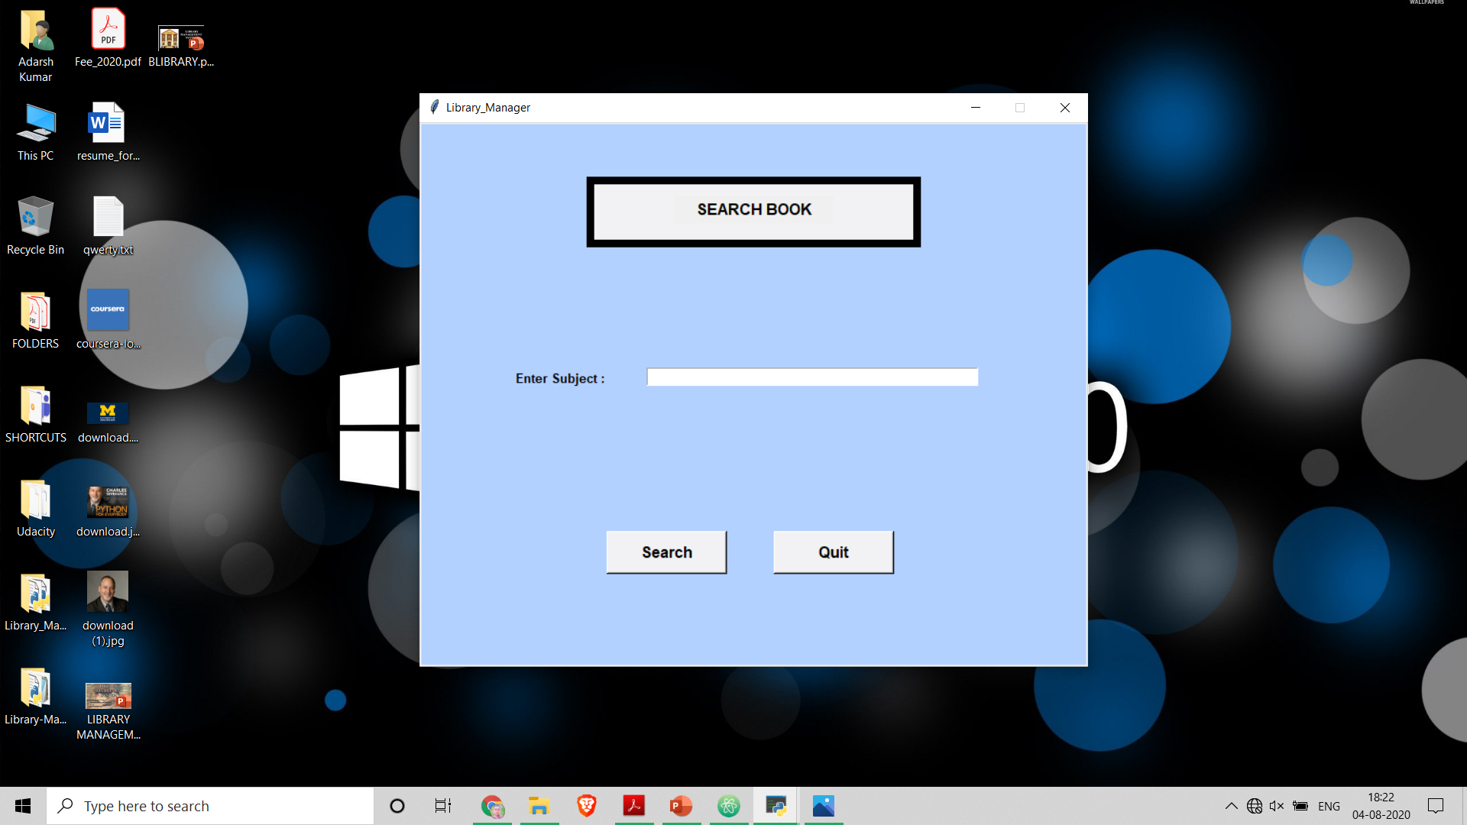
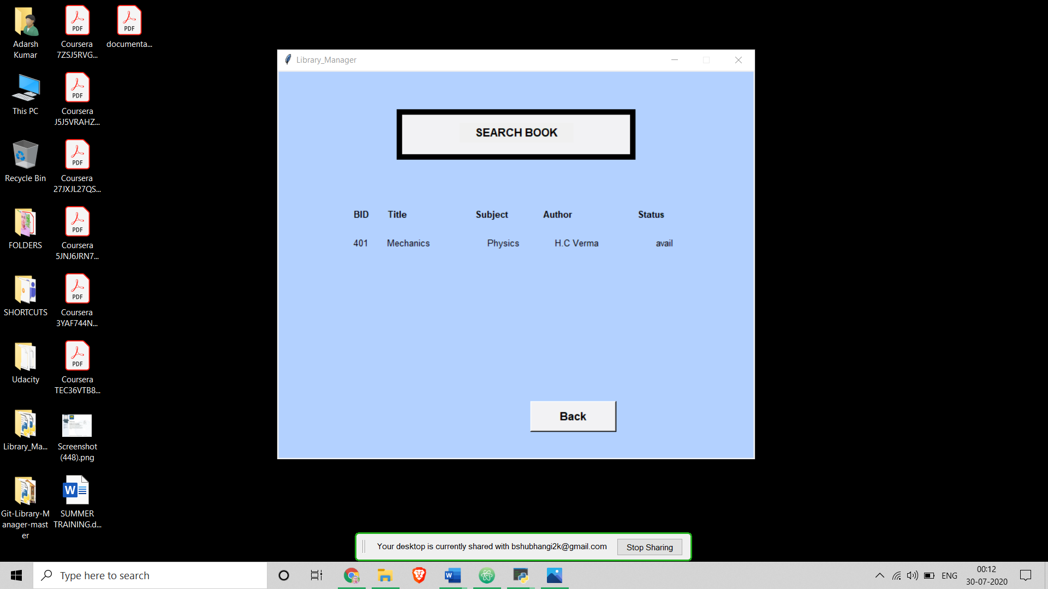
SEARCH BOOK

Slide 11
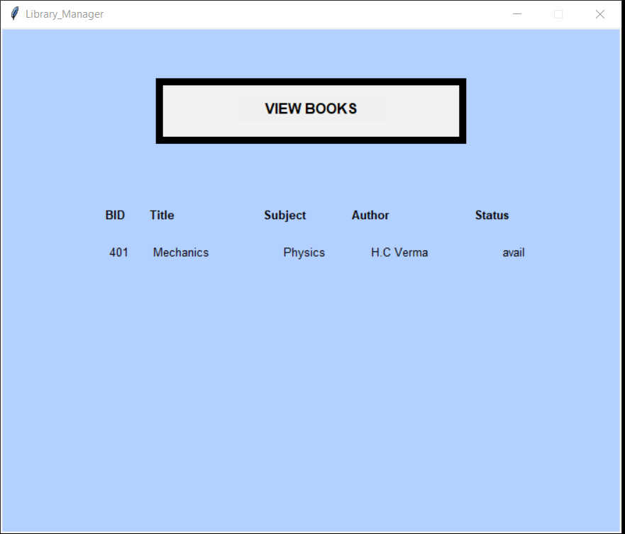
VIEW BOOK

Slide 12
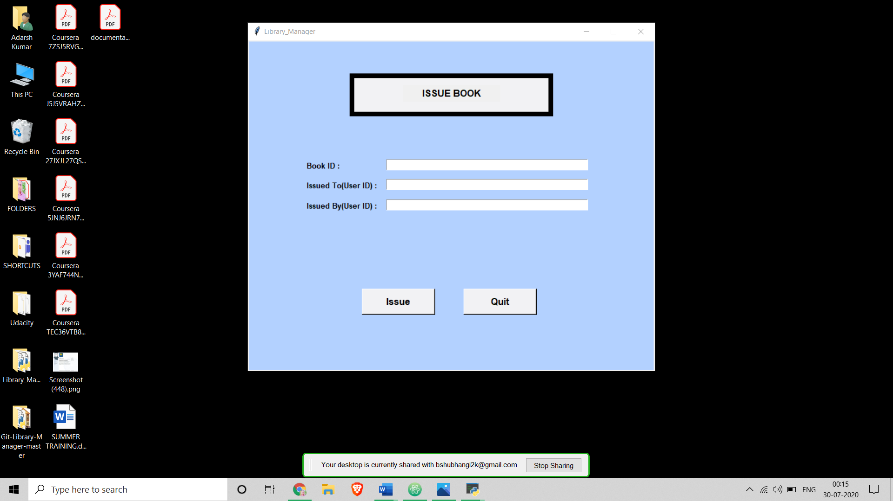
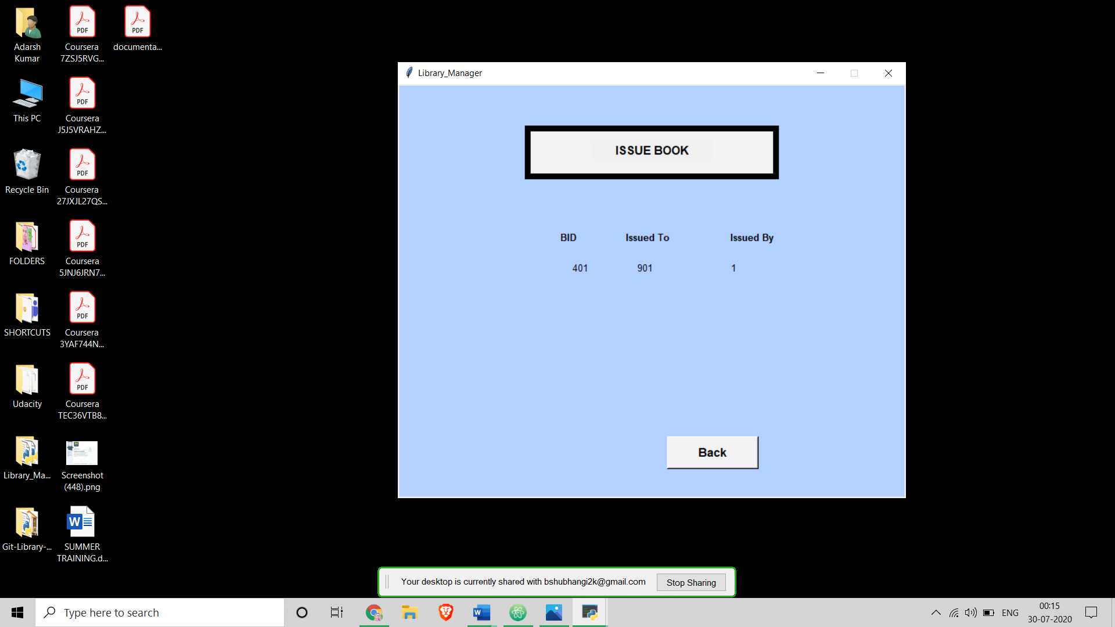
ISSUE BOOK

Slide 13
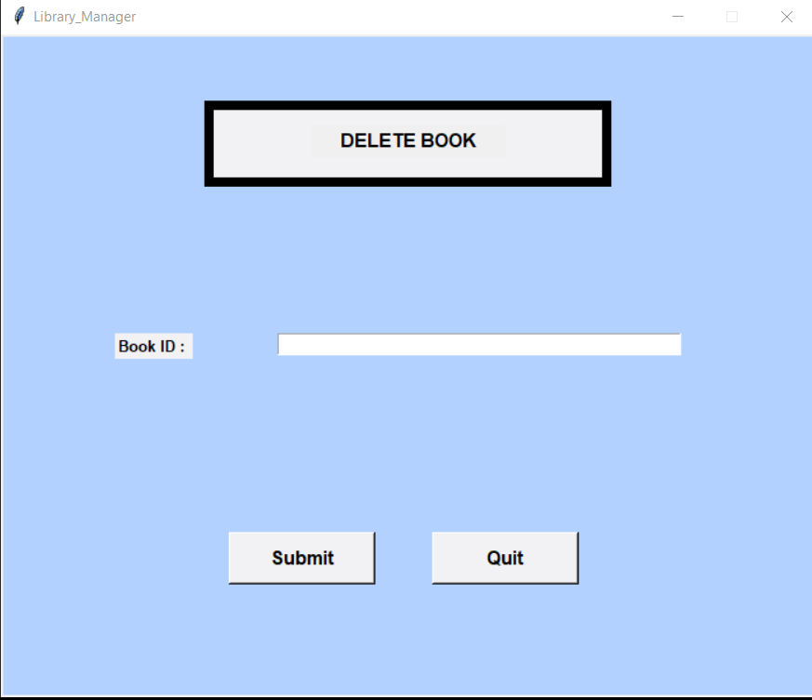
DELETE BOOK

Slide 14
CONCLUSION
The project has been completed without any problems.
We can add new features as and when required.
This has been developed by considering all the needs given in the project.
I have used CRUD Functions in it which are regularly used in the library.
This system can help in libraries to make work easy for librarian and users.

Slide 15


